Slide 1
Introduction to Apache Spark programming

Slide 2
Learning Spark
Easiest way: the shell (spark-shell or pyspark)
Special Scala / Python interpreters for cluster use
Runs in local mode on 1 core by default, but can control with MASTER environment var:
MASTER=local ./spark-shell # local, 1 thread MASTER=local[2] ./spark-shell # local, 2 threads MASTER=spark://host:port ./spark-shell # cluster
Look at the Spark API
https://spark.incubator.apache.org/docs/latest/api/core/index.html#org.apache.spark.package
Look at all the functions the RDD abstract class and PairRDDFunctions class

Slide 3
Best Current Documentation On Spark
Due to the fact Spark is so new, it is very hard to find examples of the API calls.
Matthias and I have create examples for almost all Spark RDD API calls.
Altogether 110 Spark RDD API calls!
You can get it from here
http://homepage.cs.latrobe.edu.au/zhe/ZhenHeSparkRDDAPIExamples.html

Slide 4
First Stop: SparkContext
Main entry point to Spark functionality
Created for you in Spark shells as variable sc
sc.hadoopRDD allows passing any Hadoop Configuration file to configure an input source

Slide 5
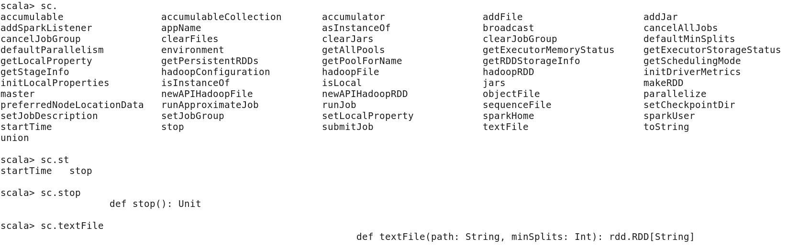
Tab completion
In spark you can use the <tab> key to get options for completing the statement.
See the examples below.
At the end of each of the statements below I pressed the <tab> key.

Slide 6
Creating RDDs
# Turn a local collection into an RDD
sc.parallelize([1, 2, 3])
or
val colors = List(“red”, “blue”, “green”)
sc.parallelize(colors)
# Load text file from local FS, HDFS, or S3
sc.textFile(“file.txt”)
sc.textFile(“directory/*.txt”)
sc.textFile(“hdfs://namenode:9000/path/file”)
# Use any existing Hadoop InputFormat
sc.hadoopFile(keyClass, valClass, inputFmt, conf)

Slide 7
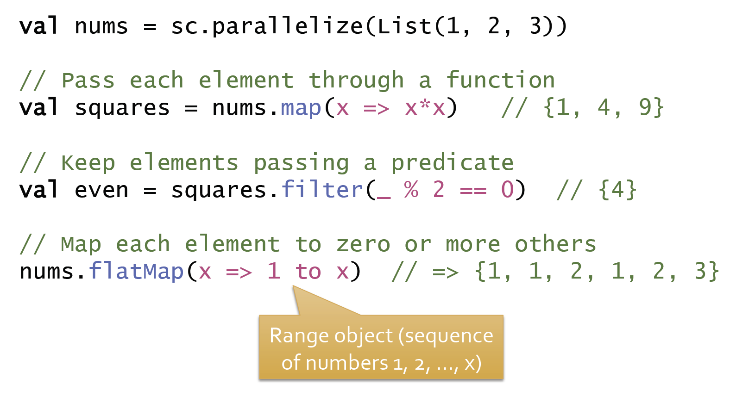
Basic Transformations
It is important to remember all these RDD transformation do not mutate the input RDD it just creates a new RDD which is populated with the updated data.

Slide 8
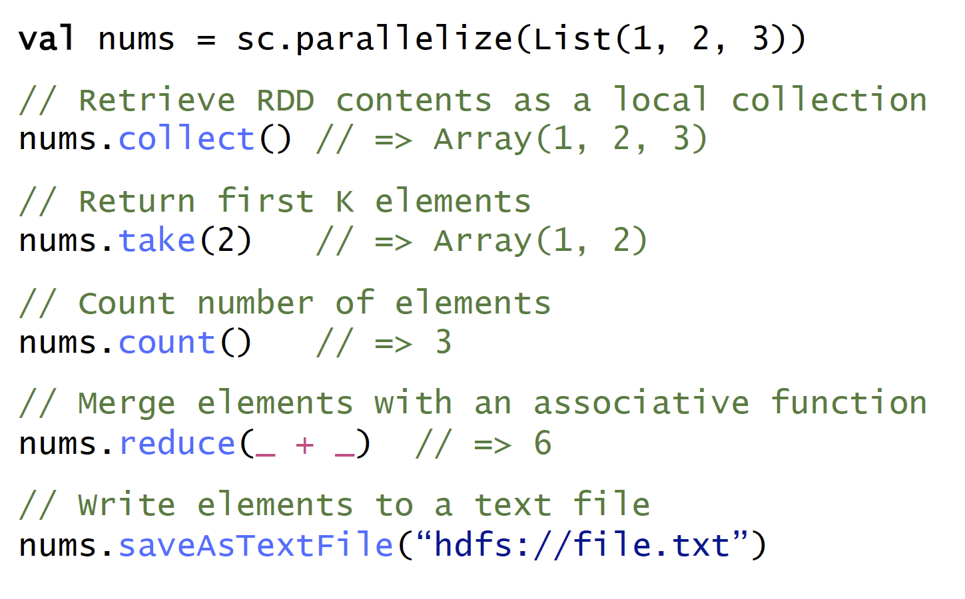
Basic Actions

Slide 9
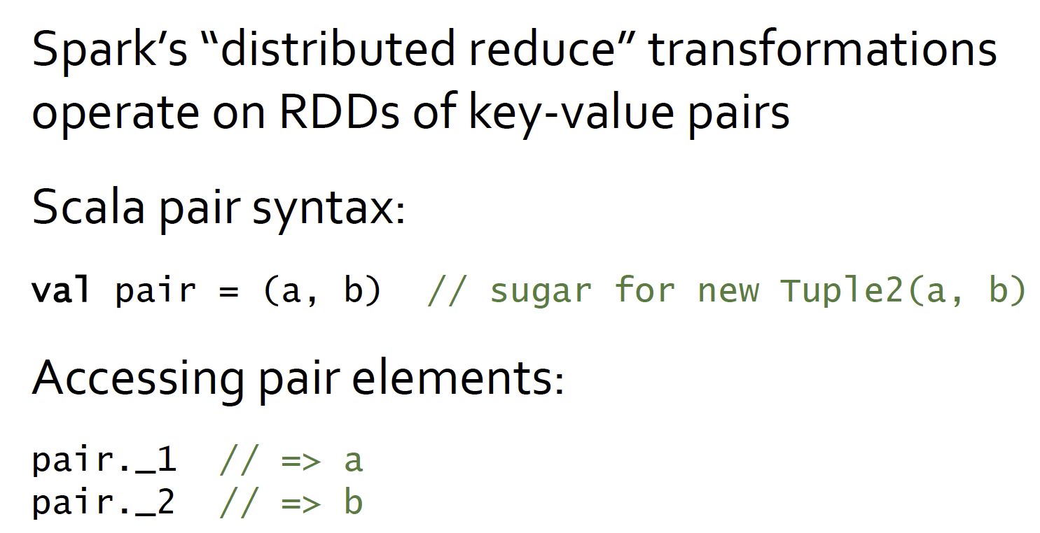
Working with Key-Value Pairs

Slide 10
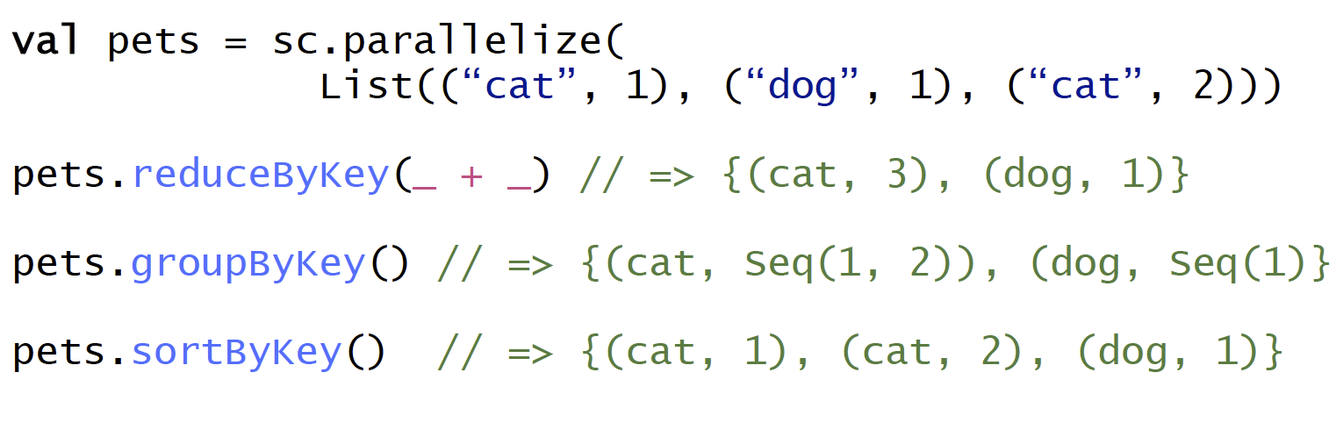
Some Key-Value Operations
I like the sortBy function better than sortByKey, since it gives you more flexibility.
pets.sortBy(x => x._1, true) // {(cat, 1), (cat, 2), (dog, 1)}
Sorts by the first attribute, in ascending order
pets.sortBy(x => x._2, false) // {(cat, 2), (dog, 1), (cat, 1)}
Sorts by the second attribute, in descending order

Slide 11
Combiners and local aggregation
In Spark functions like reduce, fold, reduceByKey, automatically have combiners implemented.
Spark automatically applies the reduce function within the parent RDD.

Slide 12
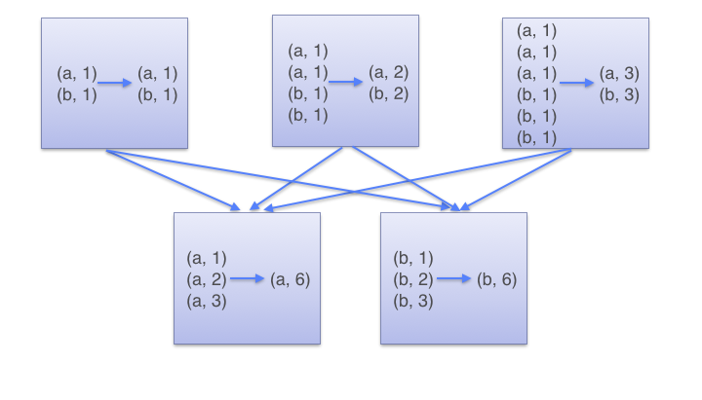
How does reduce by Key work?
reduceByKey(_ +_)
First adds up the number for each key within the local machine
mappers
Shuffles data based on key value
reducers
key b
key a
Finally sums up all values per key

Slide 13
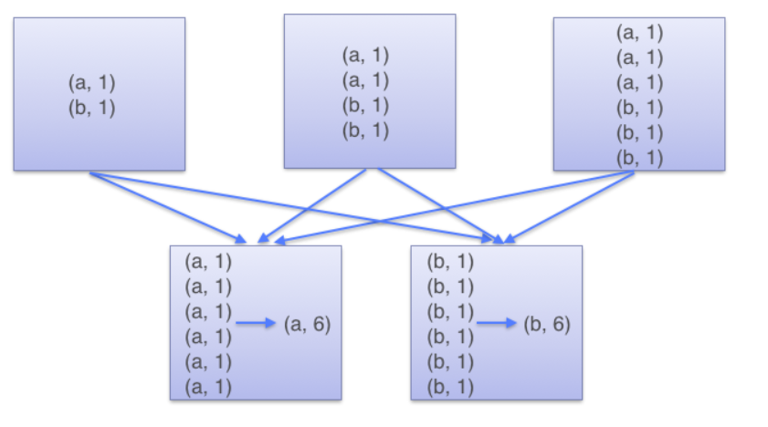

Group By Key
groupByKey()
mappers
reducers
Notice here all the data is shuffled and grouped at the reducer

Slide 14
Combiners and local aggregation
However, functions like reduce, fold, reduceByKey can only combine two inputs into one output.
What if our output has 2 elements instead of just 1?
e.g. if we wanted to find the top 2 numbers within an RDD we can not use these functions.
We can sort all the numbers and then take the top two like
Assume num is an RDD containing sequence of numbers
num.sortBy(x=>x, false).take(2)
However, this results in a lot of data shuffling
How can we use a combiner for this situation?
Use mapPartitions

Slide 15
mapPartitions versus map/reduce/reducebykey
The map/reduce/reducebykey functions only take one or pairs of input elements at a time.
RDD
9 2 1 2 1 4 1 4 9
Partition 1
Partition 2
Partition 3
The mapPartitions functions take all elements of a partition at a time as input. Thus it give you an opportunity to reduce the input from the entire partition before outputting the result.

Slide 16
mapPartitions
mapPartitions allows us to iterate through all the elements within a partition and output a different iterator containing any number of elements.
Using this we can find the top 2 within every parent partition and then only send 2 to the reducer
Using this we can perform local aggregation to reduce the amount of data shuffled. Below is the example code.
def top2(iter: Iterator[Int]) : Iterator[Int] = {
iter.toList.sortWith(_ > _).take(2).iterator
}
nums.mapPartitions(top2).collect.sortWith(_>_).take(2)
At the reducer the numbers from each of the parent RDD partitions are sorted and the top 2 returned.
Due to the use of the local aggregation there should not be too much work left for the reducer to do.

Slide 17
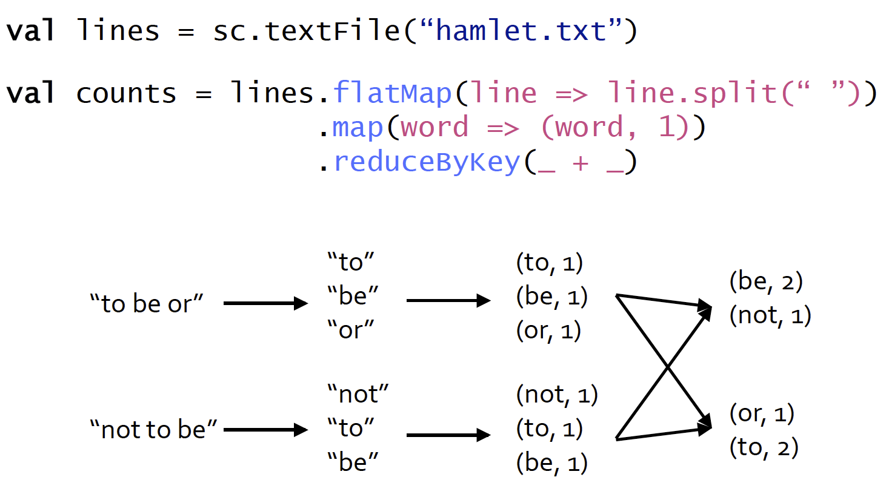
Word Count Example

Slide 18
How do we do topK words?
counts.map( x => (x._2, x._1) ).sortByKey(false).take(20)
or
counts.sortBy(x => x._2, false).take(20)
or
counts.map( {case(word, count) => (count, word)} ).sortByKey(false).take(20)
The above example returns the top 20 words in order of descending count
The map function flips the word and count key-value pairs.
Next we sort the data by the new key of count
Finally we take the top 20 tuples from the final RDD.
It is important to note after each function call above a separate RDD is produced.
So the counts.map … line creates 3 intermediate temporary RDDs.

Slide 19
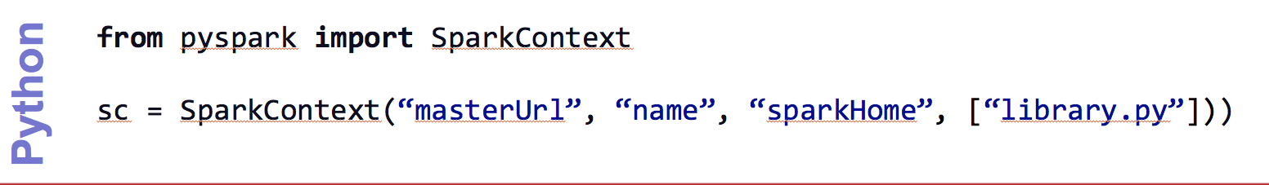
Create a SparkContext
import spark.SparkContext
import spark.SparkContext._
val sc = new SparkContext(“masterUrl”, “name”, “sparkHome”, Seq(“app.jar”))
Scala
Cluster URL, or local / local[N]
App name
Spark install path on cluster
List of JARs with app code (to ship)
import spark.api.java.JavaSparkContext;
JavaSparkContext sc = new JavaSparkContext(
“masterUrl”, “name”, “sparkHome”, new String[] {“app.jar”}));
Java

Slide 20
World Count Complete App: Python
import sys
from pyspark import SparkContext
if __name__ == "__main__":
sc = SparkContext( “local”, “WordCount”, sys.argv[0], None) lines = sc.textFile(sys.argv[1])
lines.flatMap(lambda s: s.split(“ ”)) \ .map(lambda word: (word, 1)) \ .reduceByKey(lambda x, y: x + y) \ .saveAsTextFile(sys.argv[2])

Slide 21
Word Count Complete App: Scala
import spark.SparkContext
import spark.SparkContext._
object WordCount { def main(args: Array[String]) {
val sc = new SparkContext(“local”, “WordCount”, args(0), Seq(args(1))) val lines = sc.textFile(args(2)) lines.flatMap(_.split(“ ”)) .map(word => (word, 1)) .reduceByKey(_ + _) .saveAsTextFile(args(3)) } }

Slide 22
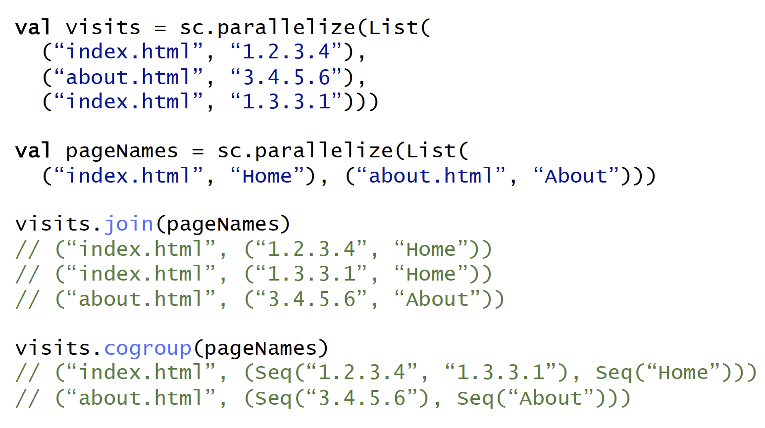
Other Key-Value Operations

Slide 23
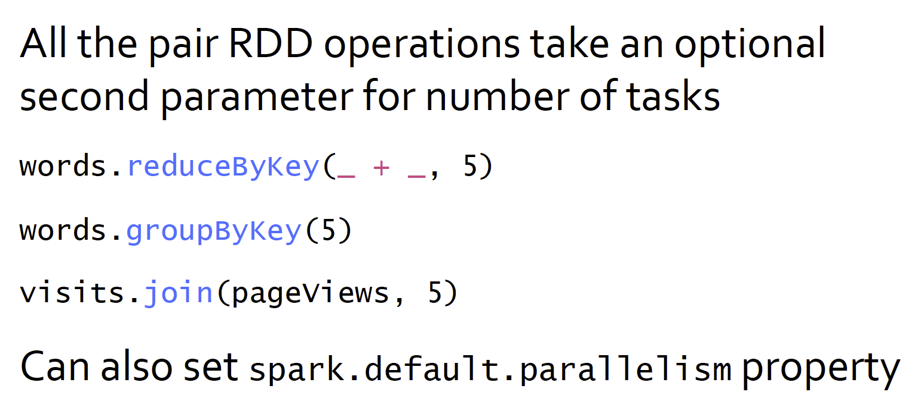
Controlling The Number of Reduce Tasks

Slide 24
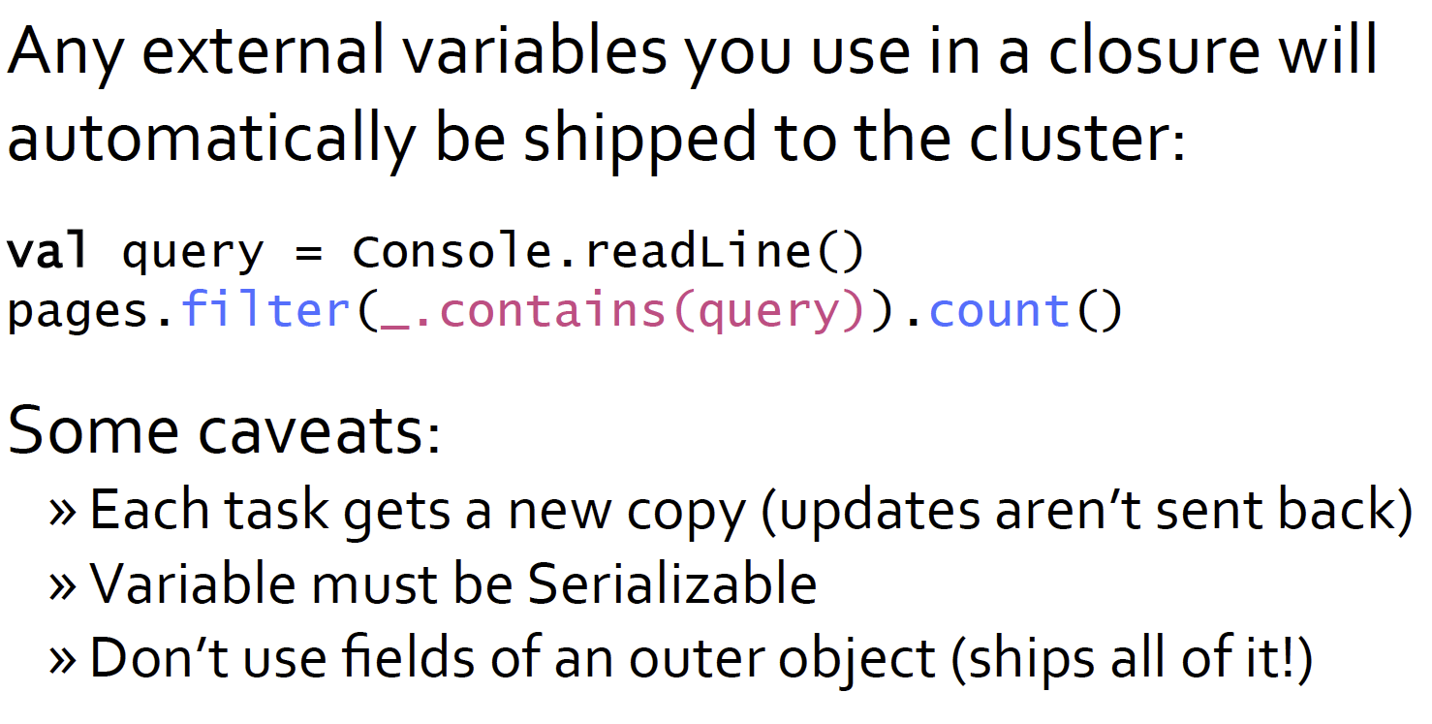
Using Local Variables

Slide 25
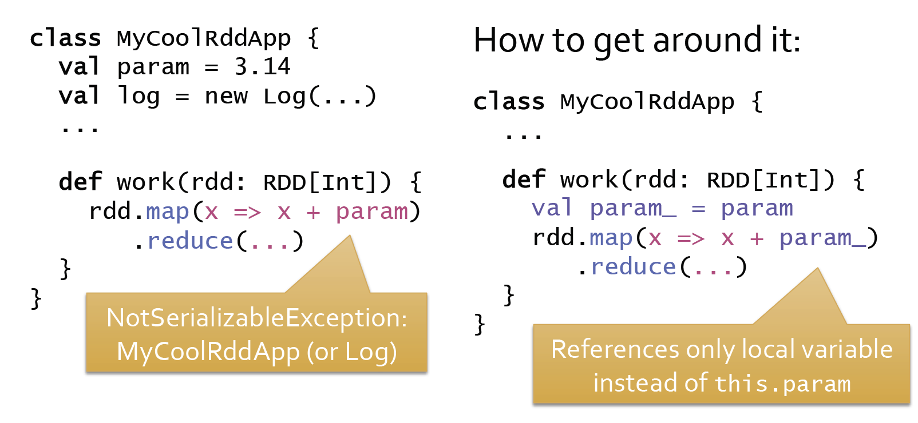
Closure Mishap Example
Even though we are just using the param member of the class MyClassRddApp, the entire object need to be serialized and shipped across the network to all the nodes.
If some part of the object is not serializable you will get an exception.

Slide 26
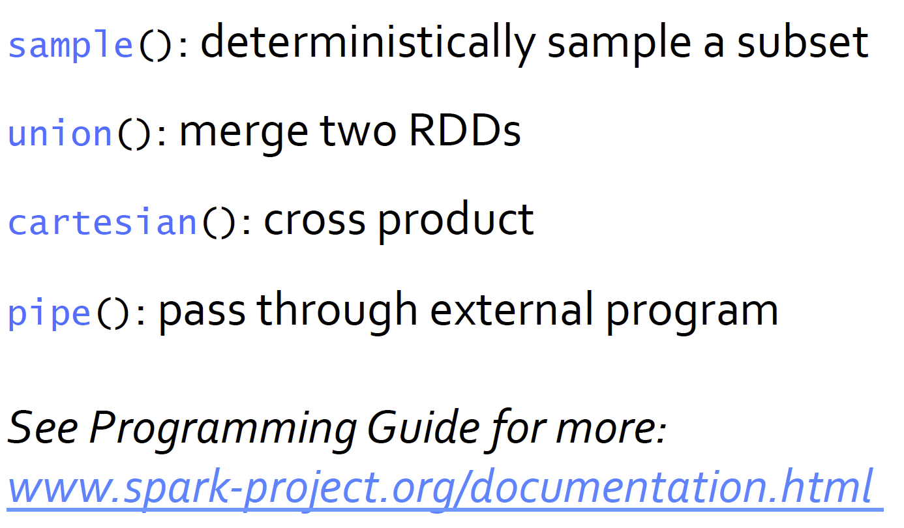
Other RDD Operations

